Slide 1
USC Benefits Administration
Making a Successful Transition to Retirement

Slide 2
Six Months Prior to Retirement
| 2
Meet with your financial planner to develop retirement income plan.
Work with your dean, supervisor, or department chair to prepare for transfer of duties and responsibilities.
If you are under age 65, compare the costs of an individual purchase of health coverage to COBRA coverage.

Slide 3
Three Months Prior to Retirement
| 3
Meet with Benefits Retirement Navigator.
Apply for Medicare Part B.
If over age 65, have form entitled, “Employer Verification” completed by the Benefits office.
Set up direct pay agreement for Long-term care insurance.
Sign up for Social Security payments if your financial plan includes benefits at this time.
Make arrangements for maintenance of USC electronic services as needed.

Slide 4
One Month Prior to Retirement
| 4
Sign up for Medicare Part C Plan
Or
Sign up for Medi-gap or Medicare Supplement Plan
And
Medicare Part D plan.
Complete retirement income planning with Financial Planner.
Arrange for continuation of any USC-sponsored insurance by contacting the applicable providers directly.
Choose three things you wish to accomplish during the first month of retirement.

Slide 5
Last Day of Employment
5
Make arrangements for final paycheck.
Turn in parking permit and employee identification card.
Complete exit interview.
Turn in any badges, keys, or equipment.
Celebrate!

Slide 6
Post Retirement
| 6
Apply for Gold Card.
Join the Staff Retirement Association or Retired Faculty Association.
Become part of the Emeriti Center.
Complete retirement income distribution paperwork.
ERISA Process

Slide 7
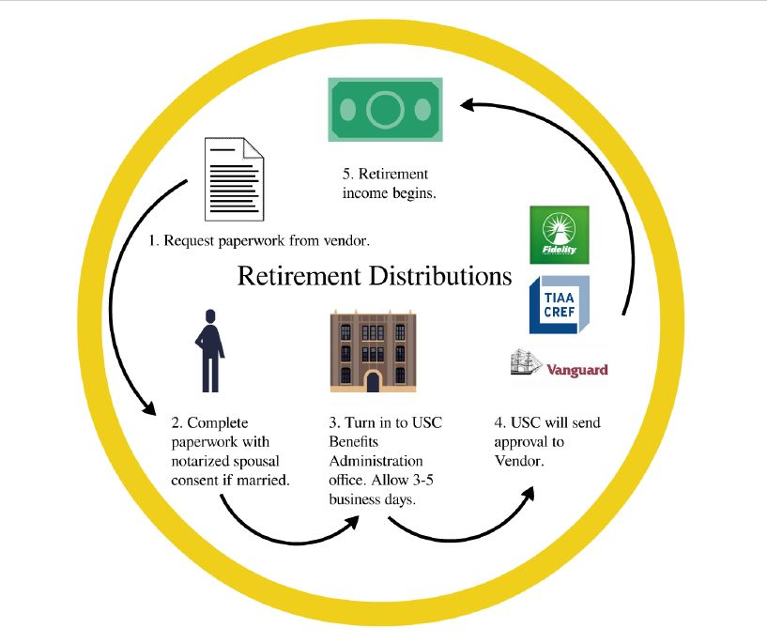
Post Retirement
| 7

Slide 8
Our Contact Info
| 8
Office of Benefits Administration
Building: 1150 S. Olive St., Suite 1340
Hours: 9:00 a.m. to 4:30 p.m.
Phone: 213-821-8100 HR Service Center
Fax: 213-740-3875
E-mail: uschr@usc.edu
Web: http://www.usc.edu/benefits

Slide 9
Disclaimer
| 9
This summary of USC’s benefit plans has been designed to acquaint you with some of the basic features of the plans, and every attempt has been made to summarize these programs and policies accurately. However, this summary is not designed to serve as your reference for the details of these benefits. Please refer to the Benefits website for more information, including details about limitations of benefits and your legal rights. The actual provisions of each benefit plan will govern if there is any inconsistency between this summary and USC’s formal plans and contracts. This summary does not constitute a contract for any benefit; USC reserves the right to modify or terminate its benefit plans.

